Slide 1
Python String
DVT101 – Lecture 23
- By Dataverse Tutorials

Slide 2
What is a String in Python?
String = sequence of characters
Written inside single or double quotes
Python has no separate character datatype
Strings are widely used for text handling
Emails, names, messages, logs use strings

Slide 3
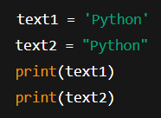
Creating Strings in Python
Single quotes ' ' and double quotes " " both valid
Functionality is same
Choice of readability matters.
Content should be within the Quotes

Slide 4
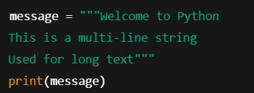
Multi-Line Strings
Triple quotes use
Multi-line text get preserved
Useful in Documentation and messages.
Newline automatically gets included

Slide 5
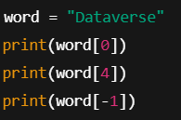
Accessing Characters in a String
Strings get indexed
Indexing starts with Zero
Negative indexing start from last
Index are always integers

Slide 6
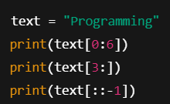
String Slicing
To get substring slicing is necessary
Syntax: string[start:end]
End index get excluded
Step value is optional

Slide 7
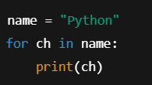
Iterating Through a String
Strings can be iterable
Access the character with for-loop
Useful in Validation and analysis

Slide 8
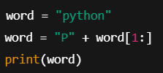
String Immutability
Strings are immutable
Direct change is not allowed
New string gets created
Memory safety improves

Slide 9
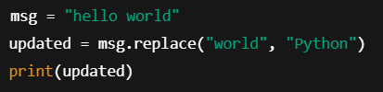
Updating and Deleting Strings
Direct update is not allowed
For Slicing new string get created
replace() gives new string
del deletes the variable

Slide 10
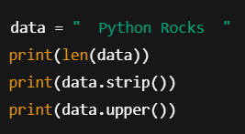
Common String Methods
len() gives length
upper() / lower() change case
strip() spaces remove
replace() text change

Slide 11

Concatenating and Repeating Strings
+ operator se join
* operator se repeat
Simple and readable syntax
+ operator used to join
* operator used to repeat
Simple and readable syntax

Slide 12

Formatting Strings
f-strings fastest and cleanest
format() older but valid
Variables can be embed

Slide 13

String Membership Testing
In keyword is used
Checks the Substring
Provide Boolean result

Slide 14
Key Takeaways
String = text data backbone
Immutable but powerful
Rich built-in methods
Essential for data science & ML pipelines

Slide 15


